Slide 1

“Final Review of Mini Project”
for E-3 2018 A
Submitted as part of Mini Project.
M. DIVYA SREE ( S180162)
D.DILLISWARA RAO (S180194)
K. GANAPATHI RAO (S180219)
Under the Supervision of:
Mr. N.SESHA KUMAR
Assistant professor
Department of Computer Science and Engineering
Rajiv Gandhi University of Knowledge Technologies
Srikakulam – 532402
1

Slide 2
Project Title “ RGUKT-SKLM PLACEMENT PORTAL ”

Slide 3
Abstract
In every educational organization, Training and Placements play an important role as it is associated to the reputation of the college and career of the students. Until now, most of the work has been done by hand at the Training and Placement Cell of RGUKT-SKLM. This project aims to build a web portal for the Training and Placement Cell of RGUKT-SKLM. Training and Placement activities are automated by this portal. It is a web-based application that helps students, recruiters and the administrative staff to perform every activity in the campus recruitment process. This portal is accessed and impressively used within the organization provided with the correct login credentials. The users of this project are expected to be students, administrative staff of RGUKT-SKLM and recruiters of a company. This portal is used by the Training & Placement of the college to maintain the recruiters and the students’ information with regard to the campus hiring. Recruiters of a company should be able to establish a connection with the college for conducting an on-campus drive using this web portal. Students should be able to fill and update the personal and academic details, see the on-going placement activities, update their profile etc. This project finally provides the best platform for the flexible interaction among users.

Slide 4
Introduction
The Training and Placement Cell plays an important role for any college as it associated to the career of the Students. The main aim of the project is to build a web portal for the Training and Placement Cell because most of the work has been done manually by the Training and Placement Cell Team. It will give the good interaction between the students and recruiters. It also reduces the man power as compared to the Existing system.

Slide 5
Motive of Proposed System
The following drawbacks in the existing system motivate us to build placement web portal .
The updates about the placement activities are done via g-mail in existing system.
There is no proper procedure to eliminate coloured noisy data and multiple degradations of historical documents.
Generally either global or local thresholding can be done on documents. Here both local and global thresholding is applied to get a well binarized image.

Slide 6
Scope of Research Work
Telugu palm leaves represent our Indian culture and they contain scientific and medicinal values.
In order to preserve them in binarized format we came up with this project.
After binarizing the palm leaves they are converted into digital format so that they can be easily preserved for future use and can be easily sharable.
This can also be extended to word level and text level segmentation.

Slide 7
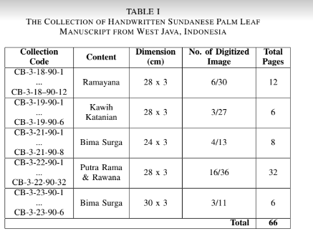
Analysis of Existing Methods/Models/Algorithms

Slide 8
Working Software
Aletheia software is used to create a dataset. The following are the steps to use Aletheia to create a ground truth image to the respective input image:
Step 1 : Open Aletheia software and then click new page to upload a new input image
Step 2: Now set the appropriate threshold value .
In the tool bar click image => Binarize => Threshold(manual)
Step 3: Now remove the noise by choosing remove noise under image in the tool bar.
Step 4: Zoom in and Zoom out the interface to your comfort and eliminate outside noise using the select component
image in the tool.
Step 5: Now make sure each character in the image should be clean and neat.
Step 6: Erase all the remaining noise using either eraser or select components and delete component options available under image in the tool bar.
Step 7: well binarized image is created.

Slide 9
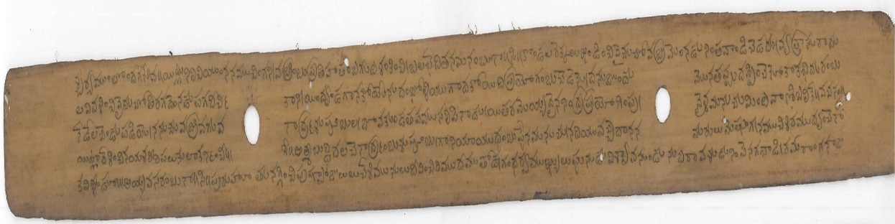
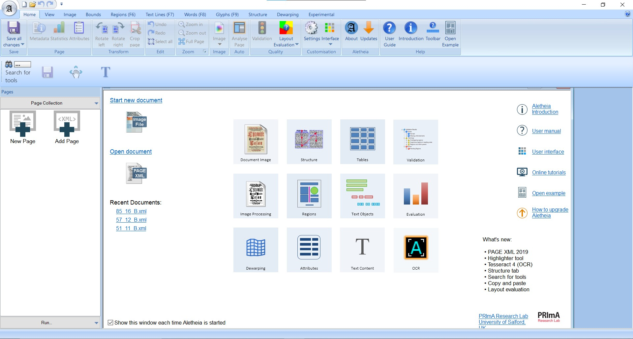
Screenshots
Input image
Binarized image

Slide 10
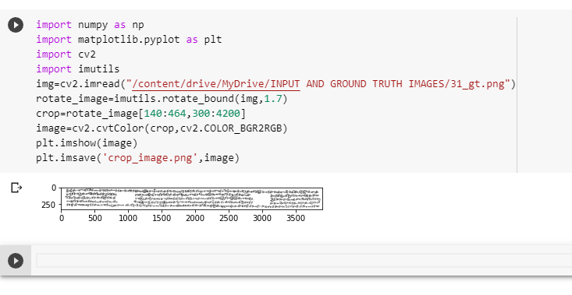
Modification of dimensions and orientation
Modification code using Matplotlib and OpenCV

Slide 11
Results & Analysis
In this paper, we first constructed a dataset for Telugu palm leaf manuscripts and then used the software called “Aletheia” to binarize them.
To the best of our knowledge, this is the very first dataset created for Telugu palm leaf manuscripts.
The proposed project converts the input image into black and white image and then we binarized the image using Alethia tools.
We evaluated the proposed method on the created Telugu palm leaf image dataset. The experimental results demonstrate that the proposed method outperforms traditional and state-of-the-art methods.

Slide 12
Conclusion
In conclusion, Training and Placement Cell website serves as a crucial platform that bridges the gap between educational institutions and industries, facilitating the seamless transition of students from academia to the professional world. The Training and Placement Cell website empowers students, enhances employability, simplifies recruitment processes, and strengthens the bond between academia and industry, ultimately paving the way for a successful transition from education to employment.
Future work:
In future work, placement cells will revolve around building strong industry partnerships, providing comprehensive career support services, and equipping students with the necessary skills to succeed in the dynamic job market. They will adapt to the evolving needs of students and employers, embracing emerging technologies and industry trends to maximize students' employability and career success.

Slide 13
References
PLACEMENT WEBSITES OF DIFFERENT UNIVERSITIES :
https://campus.placements.iitb.ac.in/ - IIT Bombay
https://placement.iitm.ac.in/ - IIT Madras
http://www.cdc.iitkgp.ac.in/p/placement - IIT Kharagpur https://www.iitg.ac.in/ccd/#/home - IIT Guwahati
https://www.iitr.ac.in/Placements/pages/index.html - IIT Roorkee
https://www.nitw.ac.in/path/?dept=/placement - NIT Warangal
https://www.javatpoint.com/
https://www.w3schools.com/
https://www.geeksforgeeks.org/

Slide 14
Thank You

